Slide 1

My Linear Relationships Interactive Notebook
Name
Class
Teacher
Semester 2
Term 4
1

Slide 2

24
7
30
Tasks
24
7
30
Essential Question
Complete the tasks on this side (left) of your page
You should be ticking these off!
Questions
Notes
Write your notes on this side (right) of your page
Summary
Have YOU been doing your summaries?
Your book, your responsibility!

Slide 3
Before we start, some quick mental maths…Your job:
Find a partner
Record your answers to the following head scratchers on a piece of paper
Don’t shout answers out!!!

Slide 4
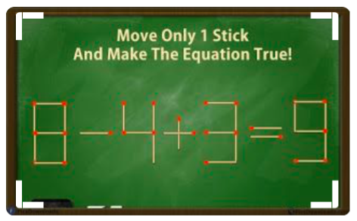

Slide 5


Slide 6
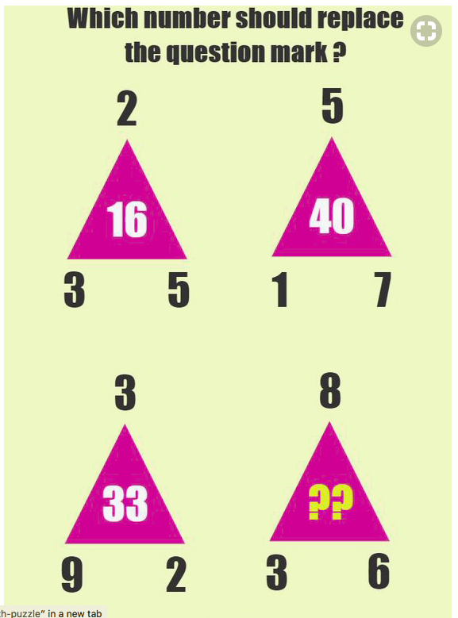

Slide 7
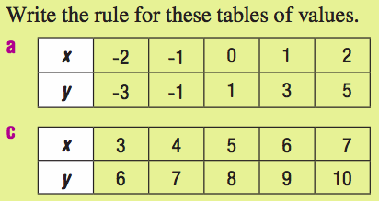
From last class
On the LHS of your INB:

Slide 8
24
7
30
Date
Linear Relationships
EQ – What are gradient and y-intercepts and how do we measure them?

Slide 9

What is the meaning of this sign?
Icy Road Ahead
Steep Road Ahead
Curvy Road Ahead
Trucks Entering Highway Ahead

Slide 10
What does the 7% mean?
7% is the slope of the road. It means the road drops 7 feet vertically for every 100 feet horizontally.
7%
7 feet
100 feet
So, what is slope???
Slope is the steepness of a line.

Slide 11
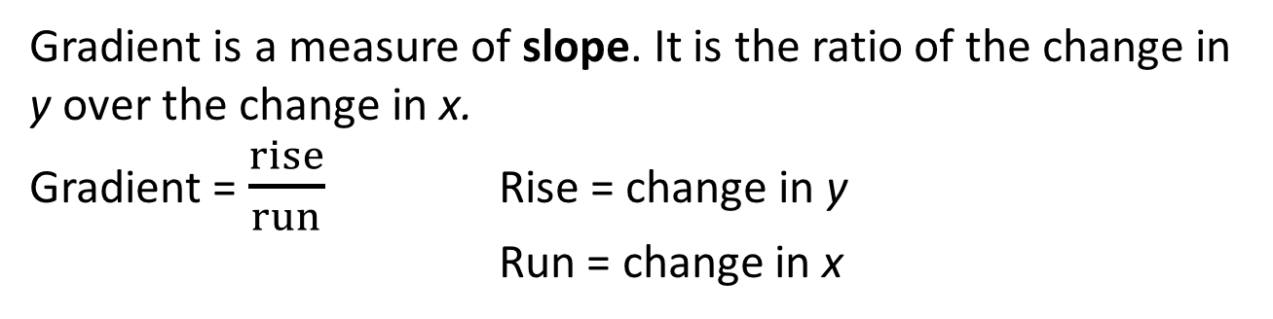
24
7
30
Date
Linear Relationships
EQ – What are gradient and y-intercepts and how do we measure them?
Gradient is a measure of slope. It is the ratio of the change in y over the change in x.
Gradient = $\frac{rise}{run}$ Rise = change in y
Run = change in x
an upwards slope
a horizontal line
a downwards slope
y
y
y
x
x
x
Positive gradient
Zero gradient
Negative gradient
If a line is vertical, its gradient cannot be specified.

Slide 12
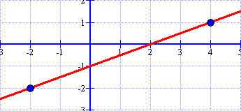
24
7
30
Date
Linear Relationships
EQ – What are gradient and y-intercepts and how do we measure them?
Consider the following line on a graph:
How do we calculate the gradient of this line?

Slide 13
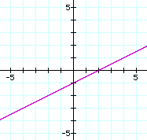
24
7
30
Date
Linear Relationships
EQ – What are gradient and y-intercepts and how do we measure them?
Start with the lower point and count how much you rise and run to get to the other point!
rise
3
=
=
run
6
6
3
Notice the slope is positive AND the line increases!

Slide 14

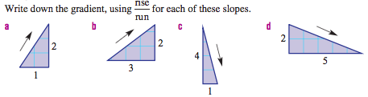
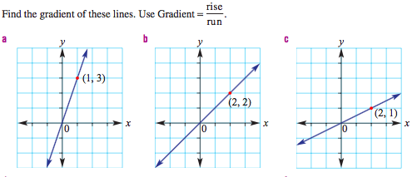
Your Turn

Slide 15
24
7
30
Date
Linear Relationships
EQ – What are gradient and y-intercepts and how do we measure them?
For those of us who work better with numbers, there is another way to calculate the gradient.
Ex) Find the slope of the line that passes through the points (-2, -2) and (4, 1).
Change in y
Change in x
y₂ is the y coordinate of the 2nd ordered pair (y₂ = 1)
y₁ is the y coordinate of the 1st ordered pair (y₁ = -2)

Slide 16
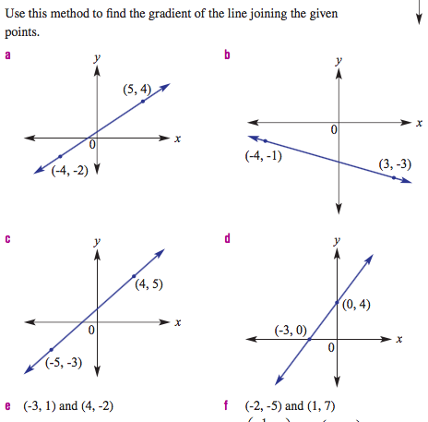
Use the formula method to find the gradient of the following:

Slide 17
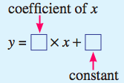
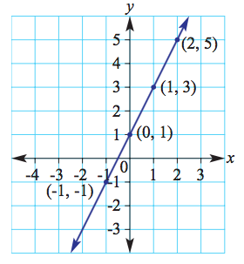
24
7
30
Date
Linear Relationships
EQ – What are gradient and y-intercepts and how do we measure them?
Last lesson when we created a rule, we used the form:
x | -1 | 0 | 1 | 2
y | -1 | 1
+2
2
1
Look at the graph and the table. What do the coefficient and constant represent on the graph?

Slide 18
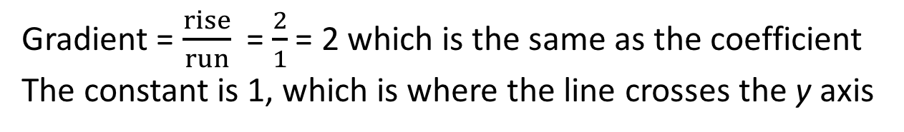
24
7
30
Date
Linear Relationships
EQ – What are gradient and y-intercepts and how do we measure them?
Gradient = $\frac{rise}{run}$ = $\frac{2}{1}$ = 2 which is the same as the coefficient
The constant is 1, which is where the line crosses the y axis
x | -1 | 0 | 1 | 2
y | -1 | 1
+2
2
1
The rule for a straight line graph is given by y = mx + c where:
m is the gradient
c is the y-intercept (where the line passes thru the y – axis)

Slide 19
24
7
30
Date
Linear Relationships
EQ – What are gradient and y-intercepts and how do we measure them?
Y- Intercept:
C stands for the Intercept
3
3
3
2
2
2
1
1
1
-1
-1
-2
-1
-2
-1
1
2
3
-2
-1
1
2
3
-1
1
2
3
-2
-2
-2
c = 2
c = 0
c = -1

Slide 20
24
7
30
Date
Linear Relationships
EQ – What are gradient and y-intercepts and how do we measure them?
Example:
Find the Gradient and y intercept of these linear functions.
y =3x – 4
y = ½x + 5
Gradient
= 3
Y-intercept
= -4
Gradient
= ½
Y-intercept
= 5
y = mx + c

Slide 21
24
7
30
Date
Linear Relationships
EQ – What are gradient and y-intercepts and how do we measure them?
Find the Gradient and y intercept of these lines.
6
6
Gradient
= 2
Gradient
= -3
4
4
2
Y-intercept
= 1
2
Y-intercept
= 3
-2
2
4
6
-2
2
4
6
-2
-2
-4
-4
y=2x + 1
y=-3x + 3

Slide 22
Work Gradient Handout (on Connect)
Notes:
Check for Understanding

